Slide 11
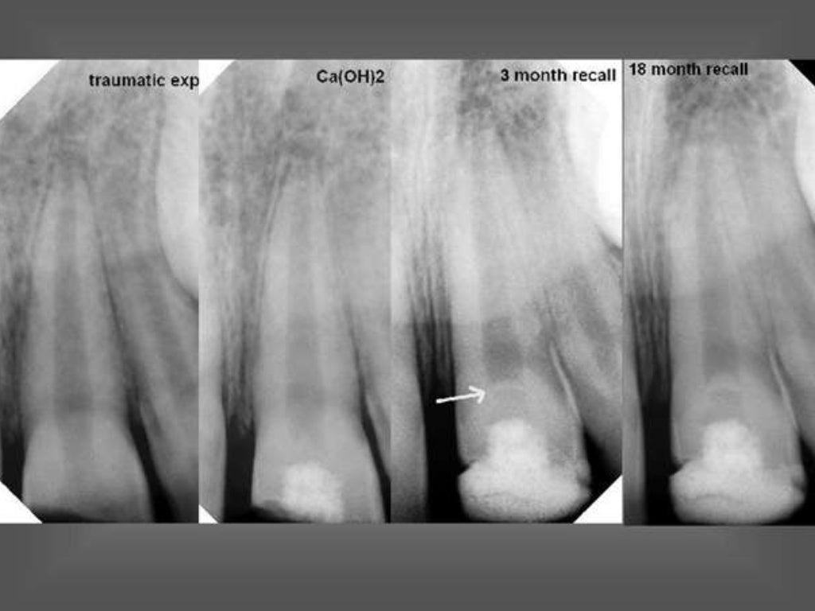

Slide 24
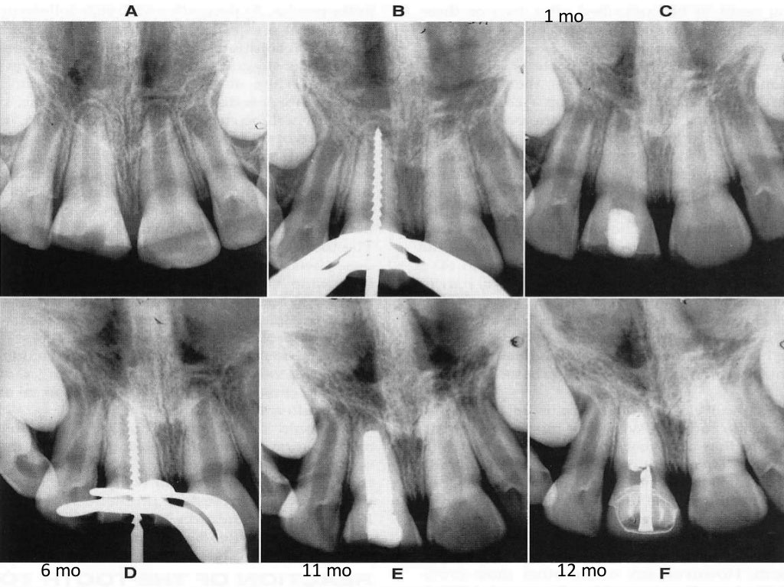

Slide 27
TAKE AWAY HOME MESSAGE
Indications of pulpotomy is mechanical pulp exposure in primary teeth.
Formocresol was introduced by Buckley in 1904.
Current newer material for pulpotomy are MTA, enamel matrix derivative.
Apexification is a method of inducing apical exposure by formation of a mineralised tissue in apical region of a non vital tooth.

